Slide 1
testing
October 2017

Slide 2

SELENIUM
Overview
Selenium is a portable software-testing framework for web applications.
Selenium is a set of different software tools each with a different approach to supporting test automation.
One of Selenium’s key features is the support for executing one’s tests on multiple browser platforms.
Selenium is composed of multiple software tools.
Selenium 2 (Selenium WebDriver)
Selenium 1 (Selenium RC or Remote Control)
Selenium IDE
Selenium Grid

Slide 3
SELENIUM
Basic Functionality
Combination of tool and DSL – Selenium is an absolute combination of tools and DSL (Domain Specific Language) in order to carry out various types of tests. It allows you to record the tests carried out through the browser. It supports multiple web browsers like Internet Explorer, Safari, Firefox, Chrome, etc.
Uses a rich language for tests – Selenium uses DSL in order to test the web applications. This language includes 200 commands and is an easy programming language to learn.
A flexible language – Once the test cases are prepared, they can be executed on any operating system like Linux, Macintosh, etc.
Reduce test execution time – Selenium supports parallel test execution that reduce the time taken in executing parallel tests.
Lesser resources required – Selenium requires lesser resources when compared to its competitors like UFT, RFT, etc.

Slide 4

testng
Overview
TestNG is a testing framework inspired from JUnit and NUnit but introducing some new functionalities that make it more powerful and easier to use.
It is an open source automated testing framework hence no cost required for implementation
TestNG is an open source automated testing framework; where NG means Next Generation.
It is designed to cover all tests : unit, functional, end-to-end, integration, etc.

Slide 5
testng
Basic Functionality
Supports annotations.
TestNG uses more Java and OO features.
Supports testing integrated classes (e.g., by default, no need to create a new test class instance for every test method).
Separates compile-time test code from run-time configuration/data info.
Flexible runtime configuration.
Introduces ‘test groups’. Once you have compiled your tests, you can just ask TestNG to run all the "front-end" tests, or "fast", "slow", "database" tests, etc.
Supports Dependent test methods, parallel testing, load testing, and partial failure.
Flexible plug-in API.
Support for multi threaded testing.

Slide 6

JUNIT
Overview
JUnit is a unit testing framework for Java programming language.
JUnit is a simple framework to write repeatable tests.
It is an instance of the xUnit architecture for unit testing frameworks.
JUnit promotes the idea of "first testing then coding", which emphasizes on setting up the test data for a piece of code that can be tested first and then implemented
"test a little, code a little, test a little, code a little."

Slide 7
JUNIT
Basic Functionality
JUnit is an open source framework, which is used for writing and running tests.
Provides annotations to identify test methods.
Provides assertions for testing expected results.
Provides test runners for running tests.
JUnit tests allow you to write codes faster, which increases quality.
JUnit is elegantly simple. It is less complex and takes less time.
JUnit tests can be run automatically and they check their own results and provide immediate feedback. There's no need to manually comb through a report of test results.
JUnit tests can be organized into test suites containing test cases and even other test suites.
JUnit shows test progress in a bar that is green if the test is running smoothly, and it turns red when a test fails.

Slide 8
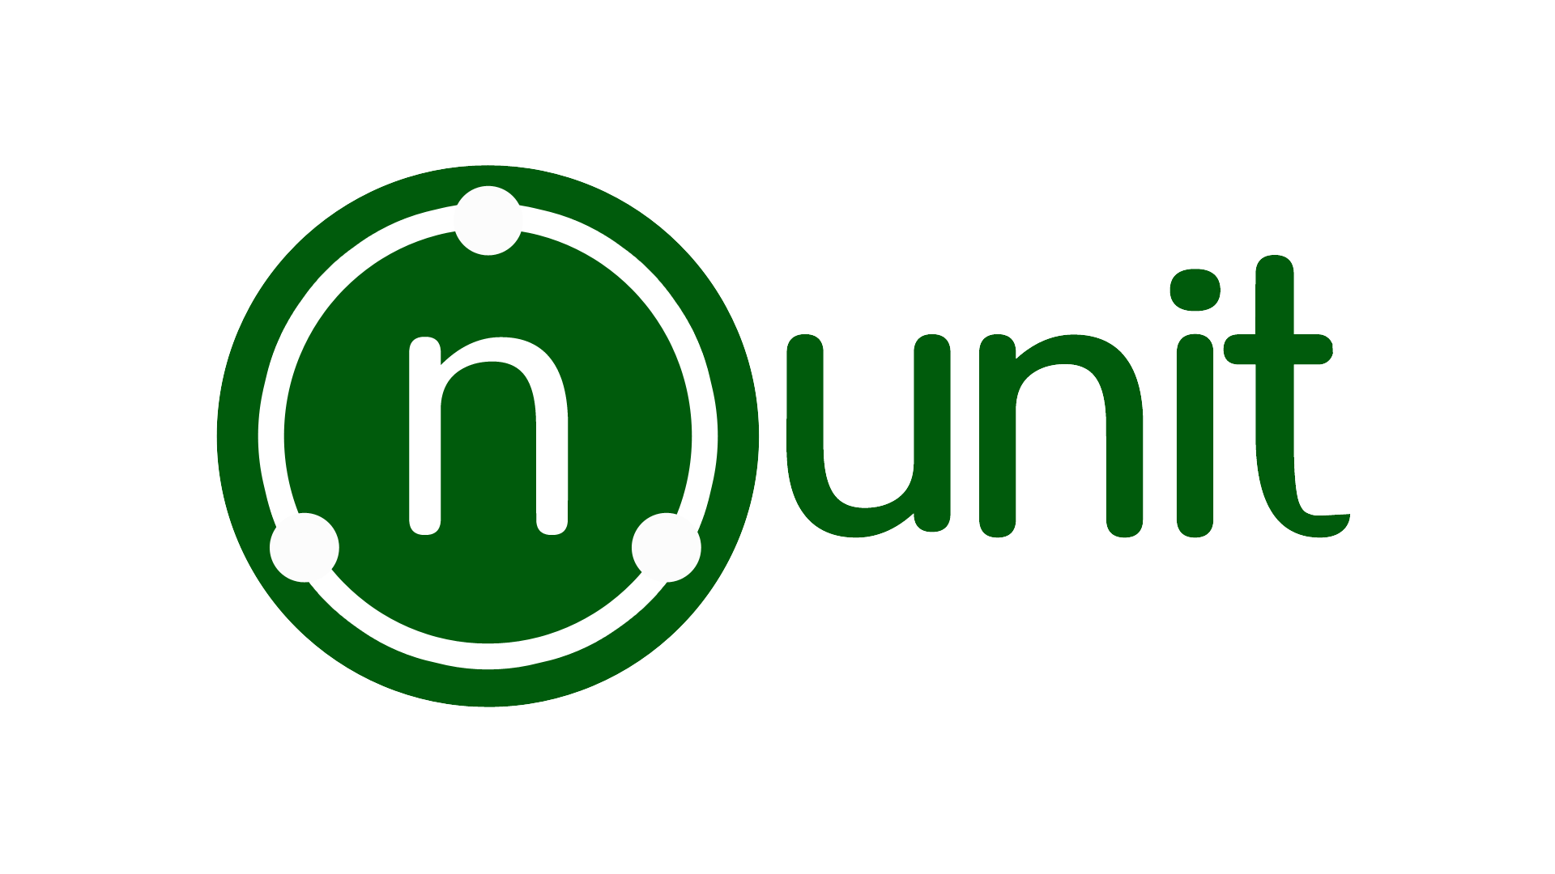
NUNIT
Overview
NUnit is a unit-testing framework for all .Net languages
NUnit is a derivative of the popular testing framework used by eXtreme Programming (XP).
NUnit works by providing a class framework and a test runner application.
The class framework allows to write test cases based on the application.
The test is run using the test runner application downloaded from the above link.

Slide 9
NUNIT
Basic Functionality
NUnit is simple to understand and easy to learn.
Object Oriented
NUnit is flexible - test code can be in any .Net language.
NUnit uses the “attribute” feature of .Net to identify tests.
Is open source and highly extensible.
Platform Independent.
When integrated in NAnt, it can be used for incremental projects.

Slide 10

Tricentis Tosca
Overview
Tosca is a Continuous Testing platform that accelerates testing to keep pace with Agile and DevOps. It is a software testing tool that is used to automate end-to-end testing for software applications. It is developed by Tricentis.
Tricentis Tosca combines multiple aspects of software testing (test case design, test automation, test data design and generation, and analytics) to test GUIs and APIs from a business perspective.

Slide 11
Tricentis Tosca
Basic Functionality
Optimize – Test Cases
Manage – Test Data
Automate – Test Cases
Maximize reuse and maintainability with model-based test automation

Slide 12
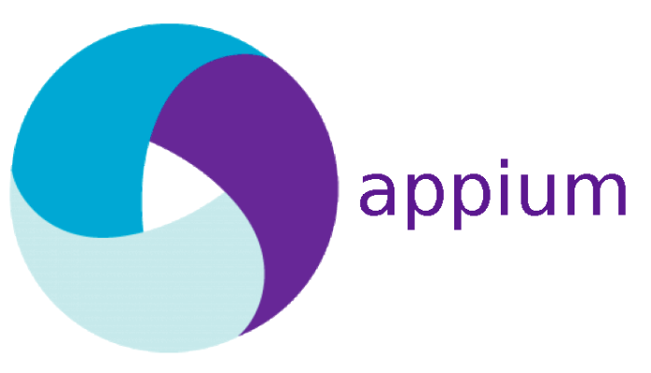
Appium
Overview
An open source, cross-platform test automation tool for native, hybrid and mobile web and desktop apps.
It also allows to run the automated tests on actual devices, emulators and simulators.
The basic philosophy of Appium is that you should be able to reuse code between iOS and Android, and that’s why when you see the API they are same across iOS and android. Another important thing to highlight here is that unlike Calabash, Appium doesn’t modify your app or need you to even recompile the app.
Appium let’s you choose the language you want to write your test in. It doesn’t dictate the language or framework to be used.

Slide 13
Appium
Basic Functionality
You don't have to recompile your app or modify it in any way, due to use of standard automation APIs on all platforms.
You can write tests with your favorite dev tools using any WebDriver-compatible language such as Java, Objective-C, JavaScript (Node), PHP, Python, Ruby, C#, Clojure, or Perl with the Selenium WebDriver API and language-specific client libraries.
You can use any testing framework.
Appium has built-in mobile web and hybrid app support. Within the same script you can switch seamlessly between native app automation and webview automation, all using the WebDriver model that's already the standard for web automation.

Slide 14

Calabash
Overview
Calabash is one framework that enables automated UI Acceptance Tests written in Cucumber to be run on iOS and Android applications. While Calabash integrates tightly with Xamarin.iOS and Xamarin.Android project, it can also be used with iOS and Android projects written in the indigenous languages of Objective-C and Java.

Slide 15
Calabash
Basic Functionality
BDD-Style acceptance testing
Ruby-based
Cross platform, supporting iOS and Android
Supported by Xamarin Test Cloud, TestObject, AWS Device Farm, etc

